Slide 1

Inflation, Money Growth
and Interest Rates

Slide 2
Cross-Country Data on
Inflation and Money Growth

Slide 3
Cross-Country Data on
Inflation and Money Growth
Inflation rates and money growth rates for 57 countries from 1960 to 2011.
We measure the price level, P, by the consumer price index (CPI), rather than the GDP deflator, because of data availability.

Slide 4
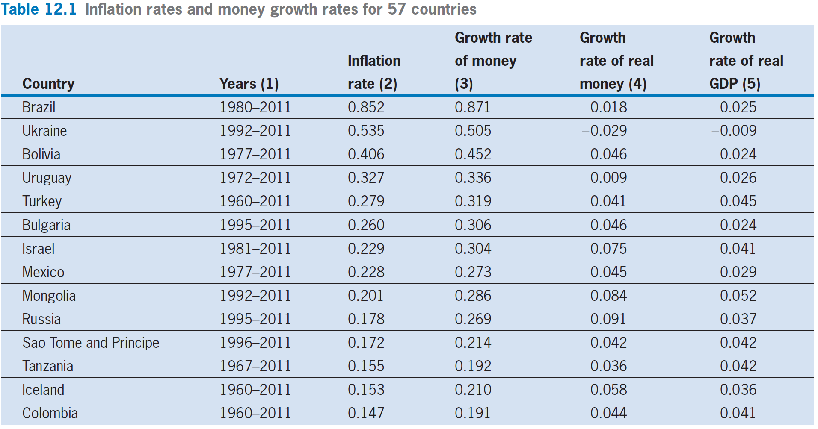

Slide 5
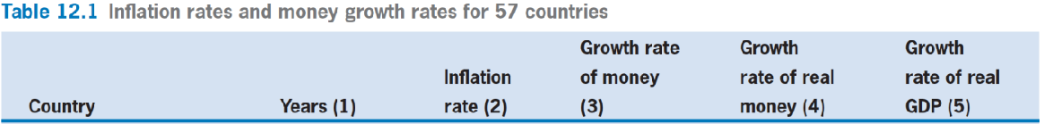


Slide 7
Cross-Country Data on Inflation and Money Growth
Highlights
  The inflation rate was greater than zero for all countries from 1960 to 2011.
  The growth rate of nominal currency was greater than zero for all countries from 1960 to 2011.
  There is a broad cross-sectional range for the inflation rates and the growth rates of money.

Slide 8
Cross-Country Data on Inflation and Money Growth
Highlights
  The median inflation rate from 1960 to 2011 was 7.3% per year, with 23 countries exceeding 10%.
  For the growth rate of nominal currency, the median was 13.6% per year, with 30 above 10%

Slide 9
Cross-Country Data on Inflation and Money Growth
Highlights
  In most countries, the growth rate of nominal currency, M, exceeded the growth rate of prices.
  For a country that has a high inflation rate in one period to have a high inflation rate in another period.
  Strong positive association between the inflation rate and the growth rate of nominal currency.

Slide 10
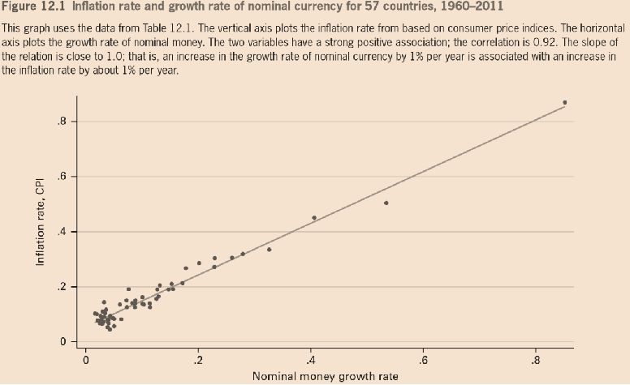
Cross-Country Data on Inflation and Money Growth

Slide 11
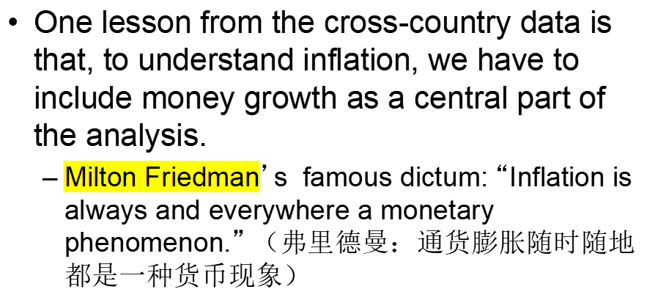
Cross-Country Data on Inflation and Money Growth

Slide 12
Inflation and Interest Rates

Slide 13
Inflation and Interest Rates
Actual and Expected Inflation
  Let π be the inflation rate. The inflation rate from year 1 to year 2，π₁, is the ratio of the change in the price level to the initial price level.
  π₁ = (P₂ − P₁)/ P₁
  = ∆P₁/ P₁
  π₁ · P₁ = ∆P₁ = P₂ − P₁
  P₂ = (1+ π₁) · P₁

Slide 14
Inflation and Interest Rates
  Since the future is unknown, households have to form forecasts or expectations of inflation.
  Denote by π^{e}₁ the expectation of the inflation rate π₁. （或者要形成P^{e}₂ ）
  The actual inflation rate, π₁, will usually deviate from its expectation, π^{e}₁, and the forecast error—or unexpected inflation—will be nonzero.

Slide 15
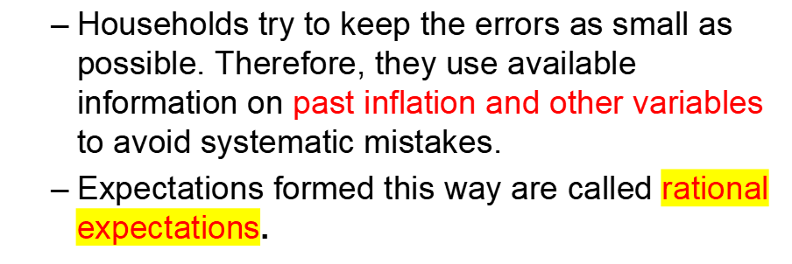
Inflation and Interest Rates

Slide 16
Inflation and Interest Rates
Real and Nominal Interest Rates
  The nominal value of assets held as bonds rises over the year by the factor 1 + i₁. The interest rate i₁ is the nominal interest rate
  The i₁ determines the change over time in the nominal value of assets held as bonds.

Slide 17
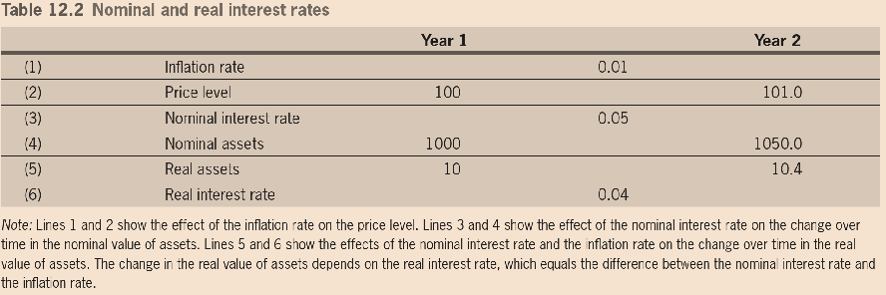
Inflation and Interest Rates

Slide 18
Inflation and Interest Rates
Real and Nominal Interest Rates
  The real interest rate to be the rate at which the real value of assets （nominal assets/price）held as bonds changes over time.

Slide 19
Inflation and Interest Rates
  nominal assets in year₂ = (nominal assets in year₁)·(1+ i₁)
  P₂ = P₁ · ( 1 + π₁)
  (nominal assets in year₂/P₂ )
  =(nominal assets in year₁/P₁) · [(1+i₁)/(1+π₁)]
  real assets in year₂
  =(real assets in year₁) ·[(1+i₁)/(1+π₁)]

Slide 20
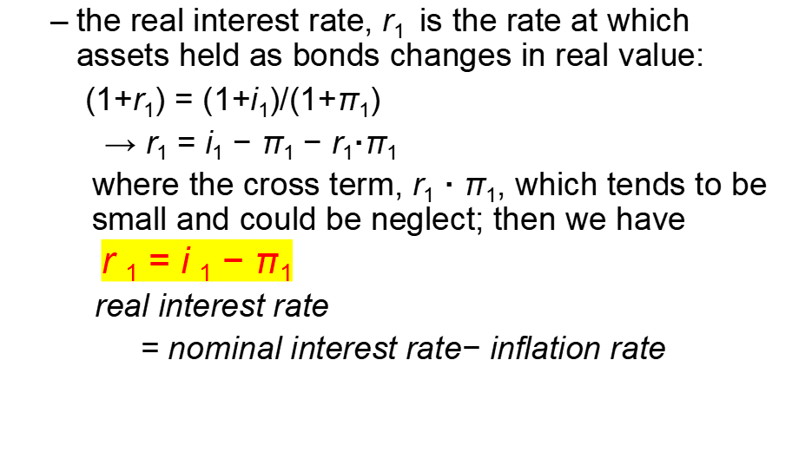
Inflation and Interest Rates

Slide 21
Inflation and Interest Rates
The Real Interest Rate and Inter-temporal Substitution
  When the inflation rate, π₁, is not zero, it is the real interest rate, r₁, rather than the nominal rate, i₁, that matters for inter-temporal substitution.

Slide 22
Inflation and Interest Rates
Actual and Expected Real Interest Rates
  The expected inflation rate determines the expected real interest rate, r^{e}_{t}
  r^{e}_{t} = i_{t} − π^{e}_{t}
    expected real interest rate=
    nominal interest rate−expected inflation rate
    i_{t} 为啥不用预期？因为 it is normally thought as the nominal interest rate on a three-month Treasury T-bill issued by the central government, which is known as not needed to forecast

Slide 23
Inflation and Interest Rates
  Measuring expected inflation
    Ask a sample of expert people about their expectations（比如美国费城联储的Livingston Survey:利文斯顿调查）
    Use the hypothesis of rational expectations, which says that expectations correspond to optimal forecasts, given the available information. Then use statistical techniques to gauge these optimal forecasts.
    Use market data to infer expectations of inflation

Slide 24
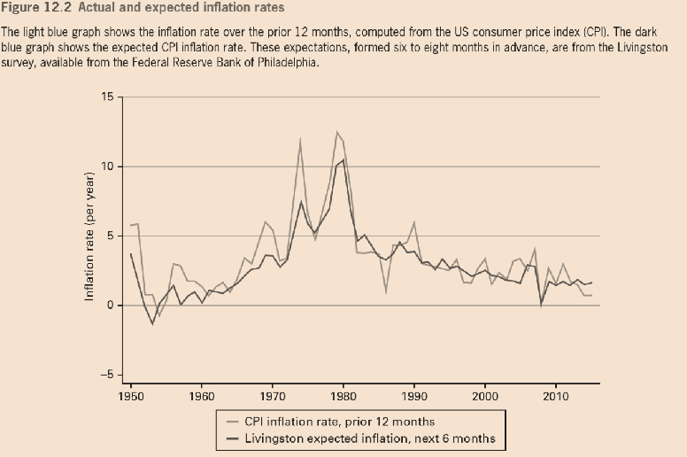

Slide 25
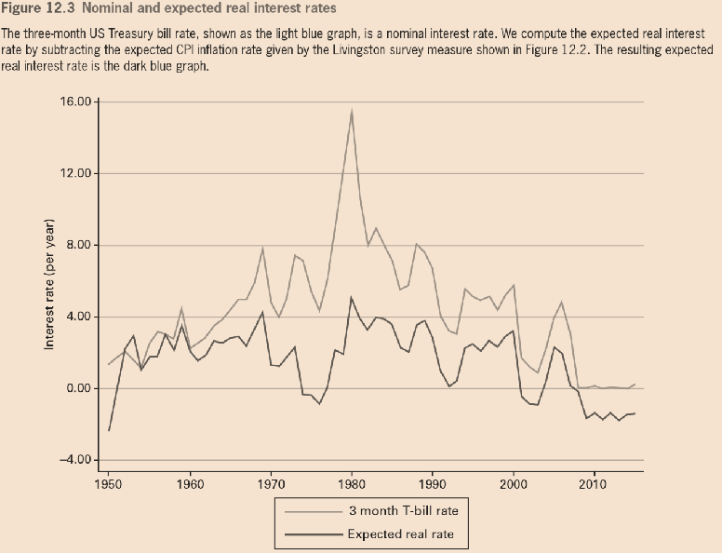

Slide 26
Inflation and Interest Rates
  Interest Rates on Money
    real interest rate on money
    = nominal interest rate on money − π_{t}
    = 0 −π_{t} = −π_{t}
    since the nominal interest rate on money is zero

Slide 27
Inflation in the Equilibrium Business-Cycle Model

Slide 28
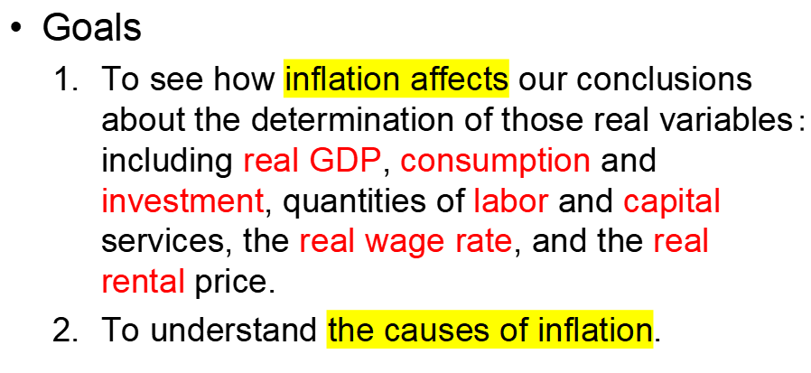
Inflation in the Equilibrium Business-Cycle Model

Slide 29
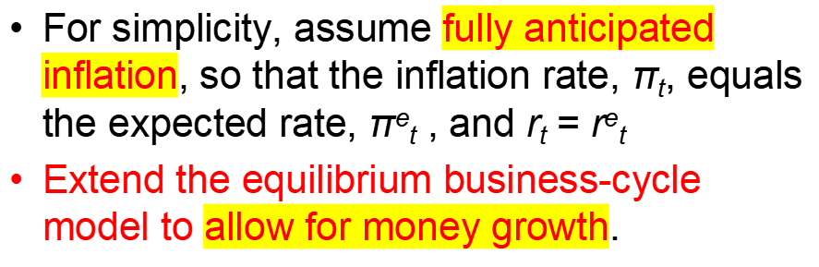
Inflation in the Equilibrium Business-Cycle Model

Slide 30
Inflation in the Equilibrium Business-Cycle Model
Assume the government prints new currency and gives it to people.
  They receive a transfer payment from the government. The payments are lump-sum transfers.
  Meaning that the amount received is independent of how much the household consumes and works, how much wealth the household holds, and so on.

Slide 31
Inflation in the Equilibrium Business-Cycle Model
1. Intertemporal-substitution effects
  The expected real interest rate, r^{e}_{t} （= r_{t},），has intertemporal-substitution effects on consumption and on labor supply.
    C₁ + C₂/(1+r^{e}₁) = (1+ r₀)·(B₀/P+K₀) + (w/P)₁ · L
    + (w/P)₂·L/(1+r^{e}₁) − ( B₂/P+K₂)/(1+r^{e}₁)
  Therefore, for given i_{t}, a change in π_{t} will have intertemporal-substitution effects.
  However, if i_{t} change with π_{t}, leading the real interest rate unchanged, there is no such effect

Slide 32
Inflation in the Equilibrium Business-Cycle Model
2. Bonds and Capital
  Households still hold two forms of earning assets: bonds and ownership of capital.
  The rates of return on these two assets have to be equal.
  When the inflation rate, π, was zero, we got the condition:
    i = (R/P)·κ − δ(κ)

Slide 33
Inflation in the Equilibrium Business-Cycle Model
  When the inflation rate, π, is nonzero, the expression (R/P)·κ − δ(κ) gives the real rate of return from owning capital. Replacing the nominal interest rate on bonds, i, by the real rate, r,
    r = (R/P) · κ − δ(κ)
    The right hand side of which is unchanged since all parts are in real terms
    The left hand side of which, r , equals i − π.

Slide 34
Inflation in the Equilibrium Business-Cycle Model
3. Interest Rates and Demand for Money
  The real interest rate on earning assets is r (= i − π), and the real interest rate on money is −π. The difference between the two real interest rates is: ( i− π) − (−π) = i
  Therefore, the nominal interest rate, i, still determines the cost of holding money rather than earning assets. We can therefore still describe real money demand by the function
    M^{d}/P = L(Y, i)

Slide 35
Inflation in the Equilibrium Business-Cycle Model
  So, it is the real interest rate, r, that has intertemporal-substitution effects on consumption and labor supply.
  However, it is the nominal interest, i, that influences the real demand for money, M^{d}/P.

Slide 36
Inflation in the Equilibrium Business-Cycle Model
4. Inflation and the Real Economy
  A change in the inflation rate, π, does not shift the demand curve or supply curve for capital services. Therefore, (R/P) * and (κK) * do not change.
  A change in the inflation rate, π, does not shift the demand curve or supply curve for labor. Therefore, (w/P) * and L* do not change.

Slide 37
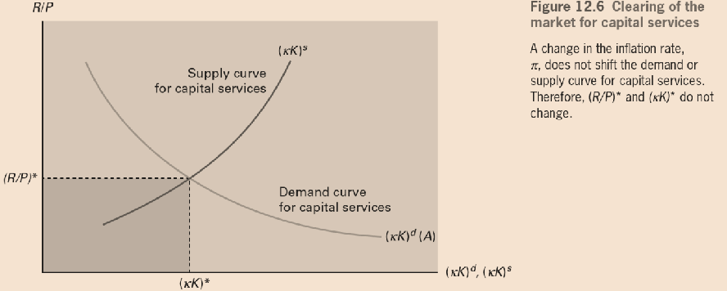
Inflation in the Equilibrium Business-Cycle Model

Slide 38
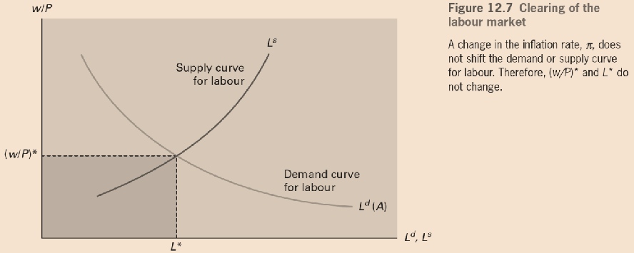
Inflation in the Equilibrium Business-Cycle Model

Slide 39
Inflation in the Equilibrium Business-Cycle Model
  Real GDP, Y, is determined by the production function
    Y= A· F(κK, L)
  A change in the inflation rate, π, does not affect the inputs of capital services and labor, κK and L. The technology level, A, is also fixed.
  We thus conclude that a change in π does not influence real GDP, Y.

Slide 40
Inflation in the Equilibrium Business-Cycle Model
  The real rental price, R/P, and the capital utilization rate, κ, determine the real rate of return from owning capital, (R/P) · κ − δ(κ), and the real interest rate, r = (R/P) · κ − δ(κ) .
  Since R/P and κ are unchanged, a change in the inflation rate, π, does not affect the real interest rate, r.

Slide 41
Inflation in the Equilibrium Business-Cycle Model
  If we continue to ignore income effects from inflation, π, since the real interest rate r and the real wage rate, w/p, are unchanged in the right hand side of household’s budget constrain.
  Then C does not change (r不变，所以也没有跨期替代效应).
  Since Y is fixed, we conclude that I does not change.

Slide 42
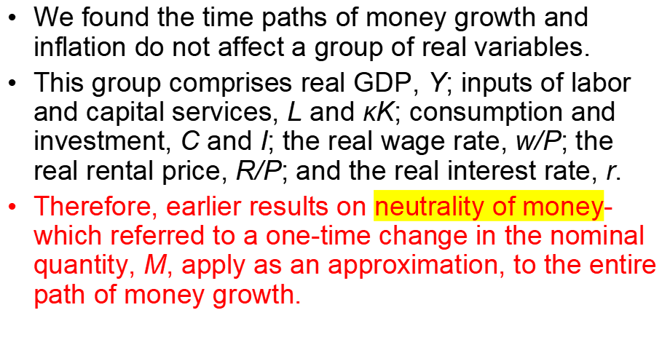
Inflation in the Equilibrium Business-Cycle Model

Slide 43
Inflation in the Equilibrium Business-Cycle Model
A Trend in the Real Demand for Money
  Assume that the real quantity of money demanded, L(Y, i), grows steadily at the constant rate γ.
  This growth rate, γ, might reflect long-term growth rate of the real GDP
  注：γ实际上就是real money growth rate,等于 nominal money growth rate - inflation rate(见第四页)

Slide 44
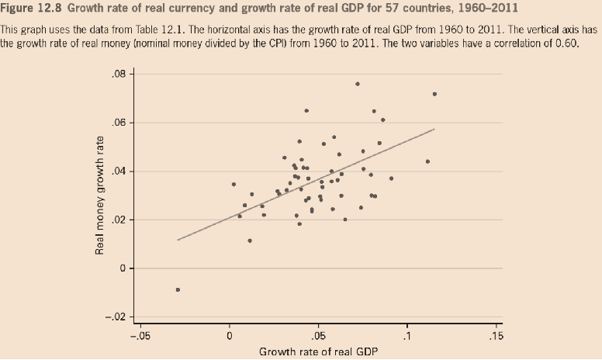
Inflation in the Equilibrium Business-Cycle Model

Slide 45
Inflation in the Equilibrium Business-Cycle Model
  Real money balances, M_{t} /P_{t}, increase because of growth in the numerator, M_{t}, at the rate µ, but decrease because of growth in the denominator, P_{t}, at the rate π.
  Growth rate of M_{t} /P_{t} = µ − π.

Slide 46
Inflation in the Equilibrium Business-Cycle Model
Government Revenue from Printing Money
  Have assumed, thus far, that the monetary authority prints new money (currency) and gives it to households as transfer payments.
  However, governments get revenue from printing money and can use this revenue to pay for a variety of expenditures.

Slide 47
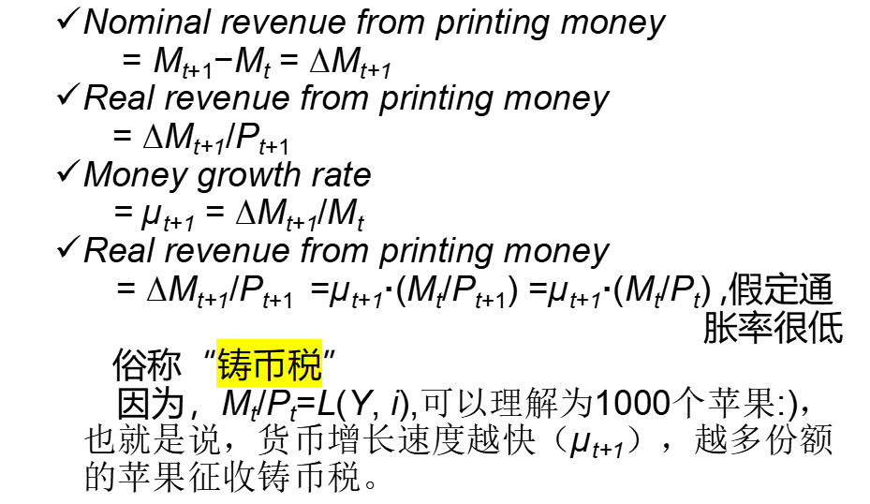
Inflation in the Equilibrium Business-Cycle Model

